Slide 1


Secure Programming
-
In the UNIX Environment
Thomas Biege <thomas@suse.de>

Slide 2
What will I talk about?
Application Design
Programming Errors
  Let’s make a short Break here. (10 min)
Cryptography and Randomness
Secure Socket Layer (SSL aka TLS)

Slide 3

Application Design

Slide 4
A SetUID Application
A Content Management System

Slide 5
A SetUID Application

Slide 6
Rules
Just don’t write it. Your Design is broken...
and your Code will be broken too. ;-)
drop Privileges as early as possible
KISS
Code Review... No, not by you.

Slide 7
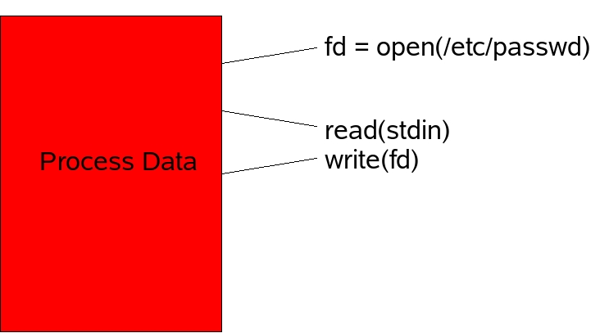
The Bad Idea

Slide 8
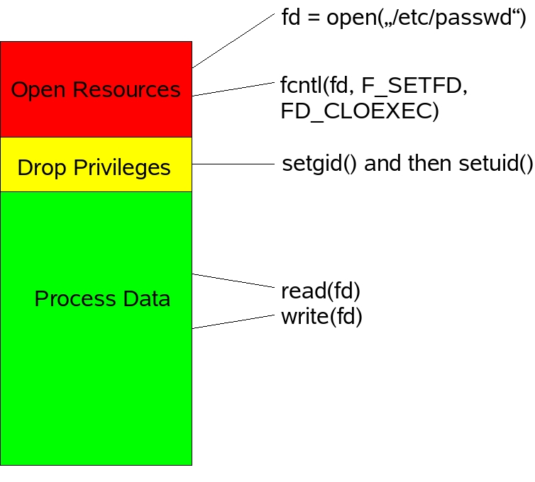
Drop Privileges

Slide 9
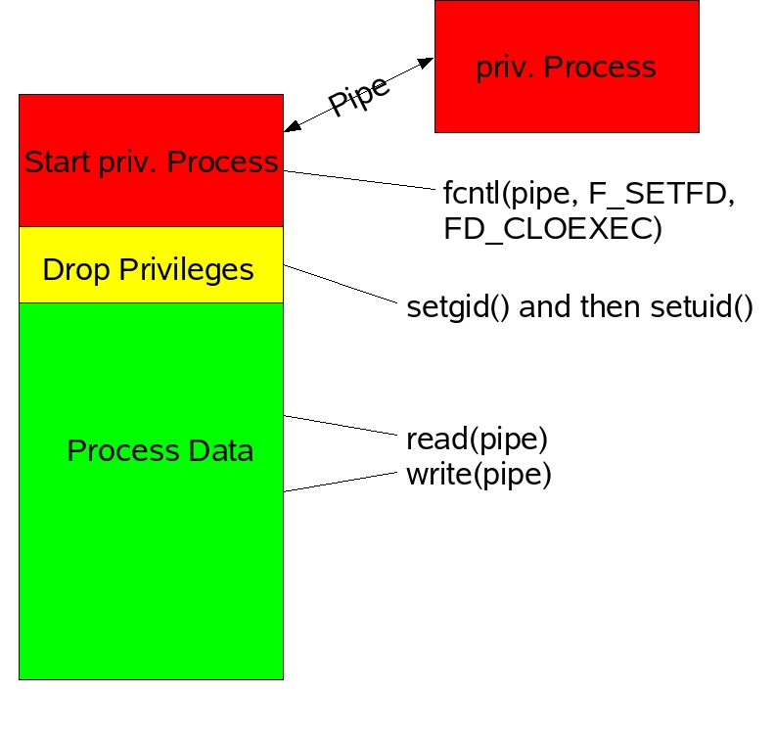
Fork a Process

Slide 10
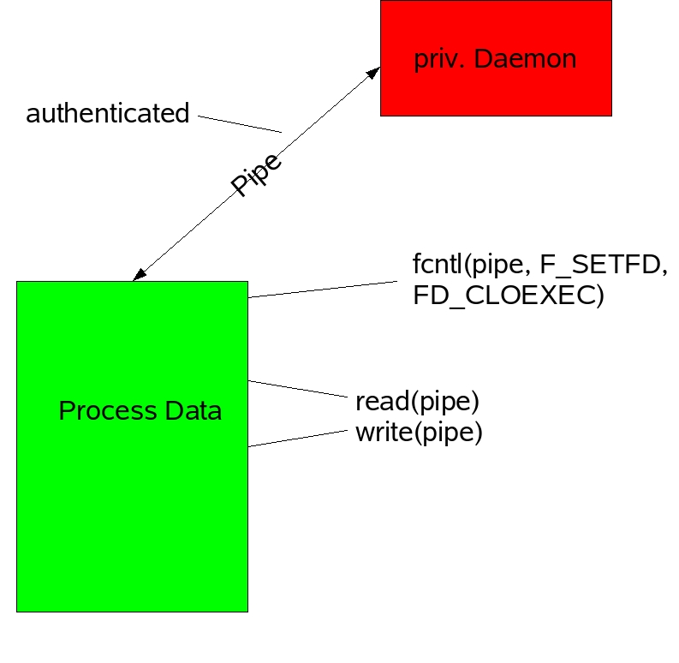
Daemon

Slide 11
A Content Management System

Slide 12
Requirements
remote Network Connections (TCP)
a secure Channel (SSL)
parallel Sessions
Authentication (LDAP)
create, open, edit HTML Files
upload binary Files into a SQL Database
view Documents (merge Files)

Slide 13
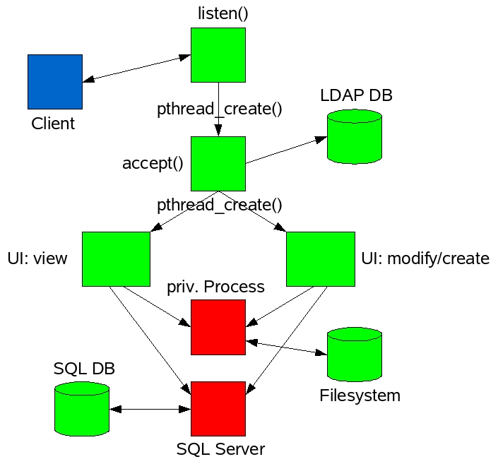
Overview

Slide 14
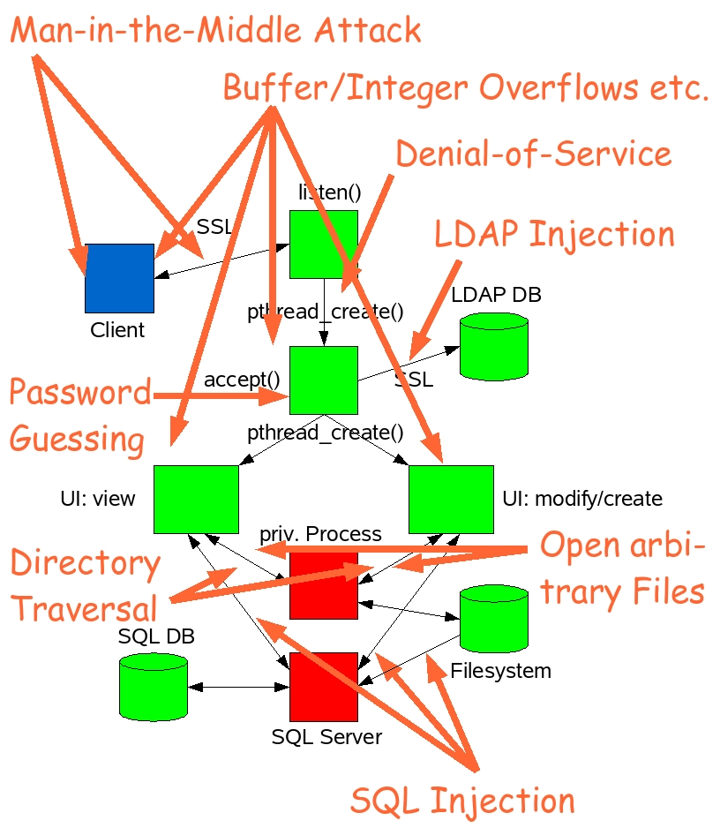

Slide 15
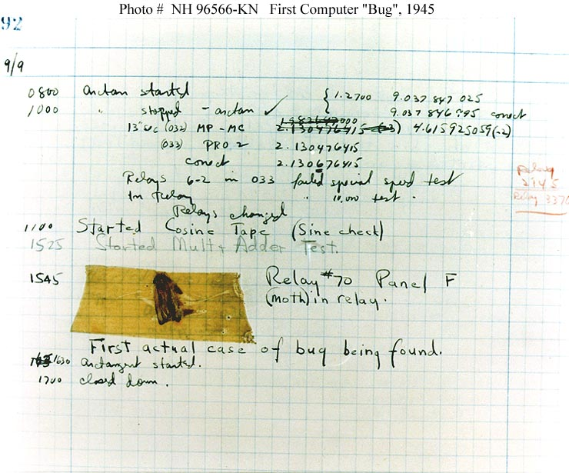
Programming Errors

Slide 16
Buffer Overflows
modular Arithmetic
Race Conditions
Format String Bugs
Untrusted Input

Slide 17
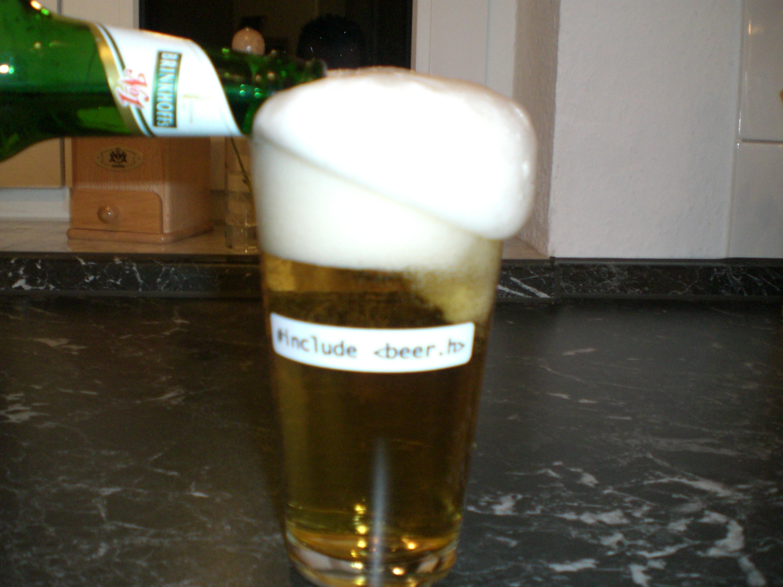
Buffer Overflows

Slide 18
ziptool - strncat(3)
switch(oper)
{
case MOUNT_DISK:
strncpy(cmd, MOUNT_CMD, strlen(MOUNT_CMD)+1);
strncat(cmd, “ -t ext2 “, 9);
strncat(cmd, dev, strlen(dev)+1);
strncat(cmd, “ “, 1);
...

Slide 19
What to avoid?
blindly using strcpy(), strcat(), sprintf()
using strncpy(), strncat(), snprintf() with wrong Parameters
Loops to copy Arrays w/o Bounds-Checking
writing Functions with Array Parameter but w/o Array-Size Parameter
trusting Input from uncontrolled/untrusted Sources... be paranoid!

Slide 20
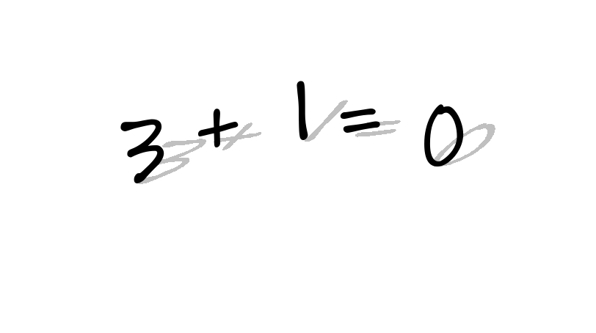
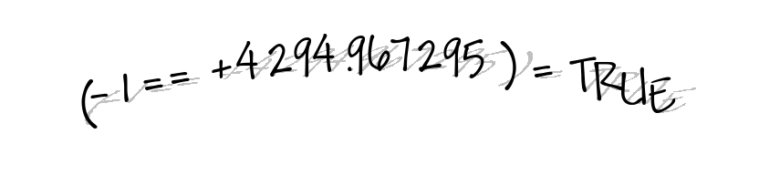
Integer Overflows
Type Mismatch
Signed Issues

Slide 21
unsigned
unsigned
+ 1
1111 1111
0000 0000
signed
unsigned
type cast
1000 0001
1000 0001
-32.767
32.767
signed
unsigned
type cast
1000 0001
1111 1111 1000 0001
-32.767
4.294.934.529

Slide 22
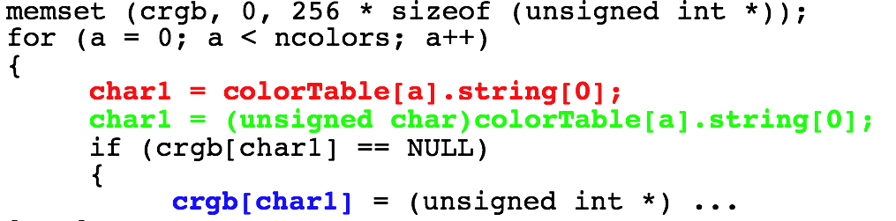
smalltalk: Type Mismatch

Slide 23
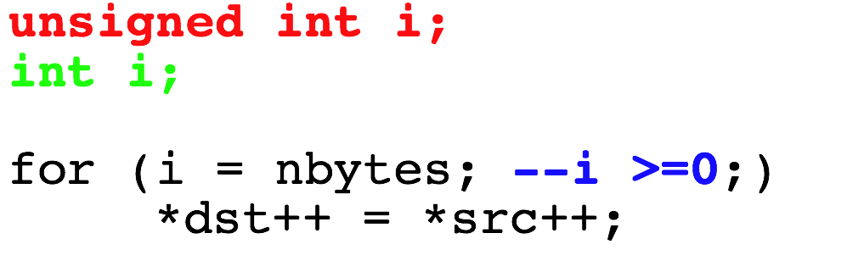
X11: Signed Issue?

Slide 24
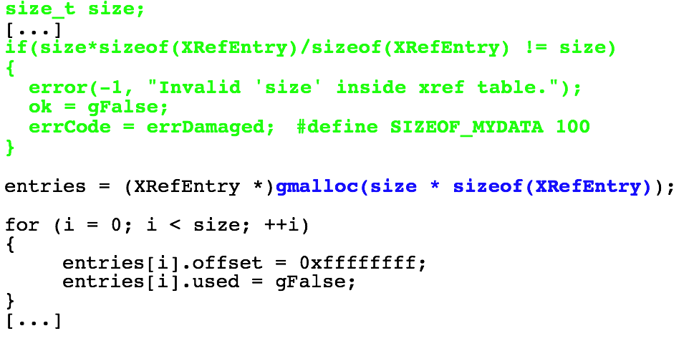
xpdf: 32 Bit vs. 64 Bit

Slide 25
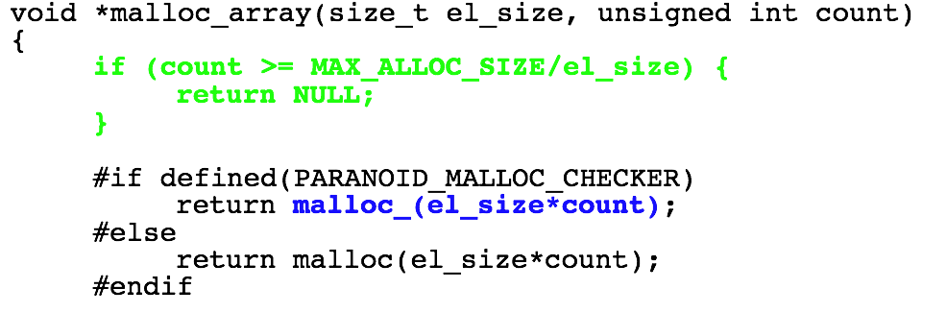
Samba: Valgrind is evil ;-)

Slide 26
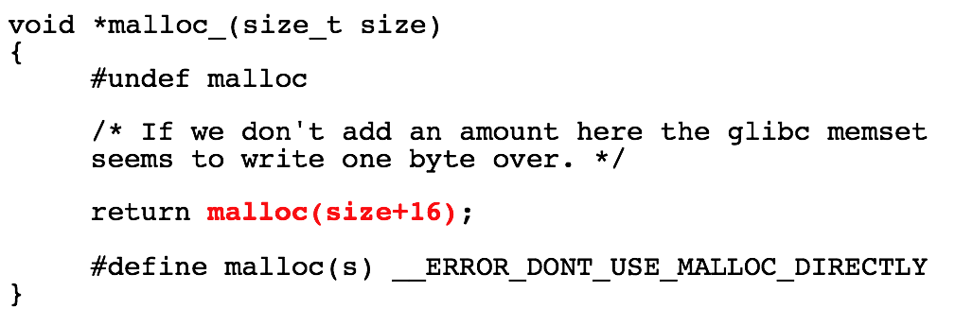
Samba: Valgrind is evil ;-)

Slide 27
What to take care off?
test for upper/lower Limits and Overflows
take care: Overflows are undefined for signed Integers
be type-safe!

Slide 28
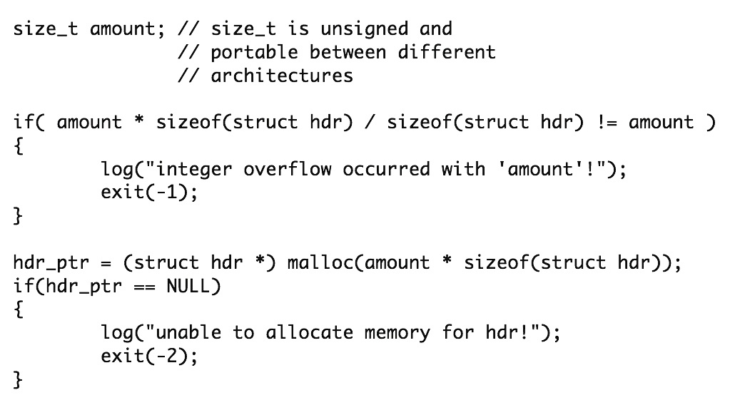
Test

Slide 29
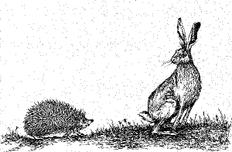
Race Conditions

Slide 30
Where?
Filesystem
multithreaded Code
distributed Databases
Signals and Interval Timer
etc.

Slide 31
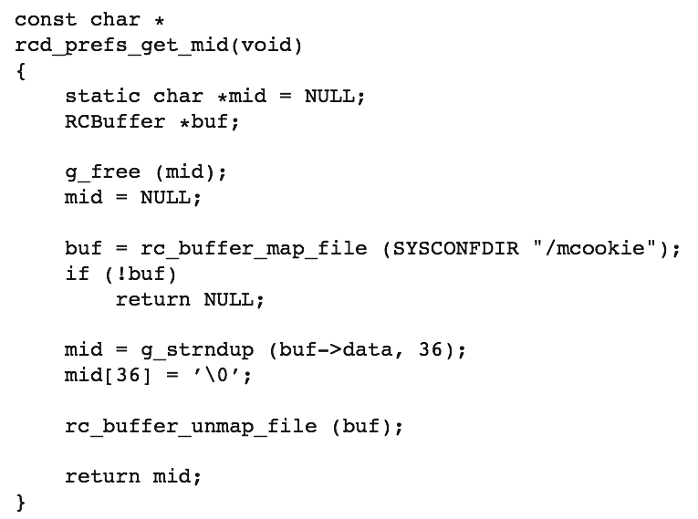
RC Server (multi-threaded)

Slide 32
RC Server (multi-threaded)
Double Free Bug due to missing Locking in multi-threaded Situation
  Result: Crash!
Lessons learned:
  use Locking
  do not use static Buffers

Slide 33
CASA’s Unix Domain Socket

Slide 34
CASA’s Unix Domain Socket The Attack
Attacker: ln -s /etc/passwd /tmp/.novellCASA
CASA: calls UnixEndPoint(/tmp/.novellCASA)
CASA: UnixFileInfo() is a Wrapper for stat(2) and follows symbolic Links: stat(/etc/passwd)
CASA: /etc/passwd is root-owned and therefore the Check for the Ownership succeeds

Slide 35
CASA’s Unix Domain Socket The Attack
Attacker: removes the Link, creates a real Socket, and attaches his Daemon
CASA: connects to this Socket (by Name)
Attacker: steals every Secret from the Client

Slide 36
How to avoid them
use Filedescriptors not Filenames
O_NOFOLLOW, O_CREAT|O_EXCL
setgid(2), initgroups(3), setuid(2) (Order!)
fork(2) + drop Privileges
mkstemp(3)
mktemp(1)
lock shared Resources while in use

Slide 37
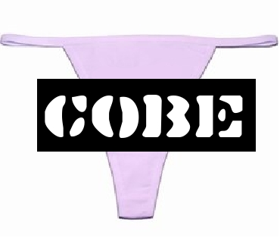
Format
String
Bugs

Slide 38
published in Year 2000
printf-like Functions
read: %x, %p
write: %n (does not work with current glibc)
Wrong
snprintf(buf, sizeof(buf), user_data)
Right
snprintf(buf, sizeof(buf), “%s”, user_data)

Slide 39
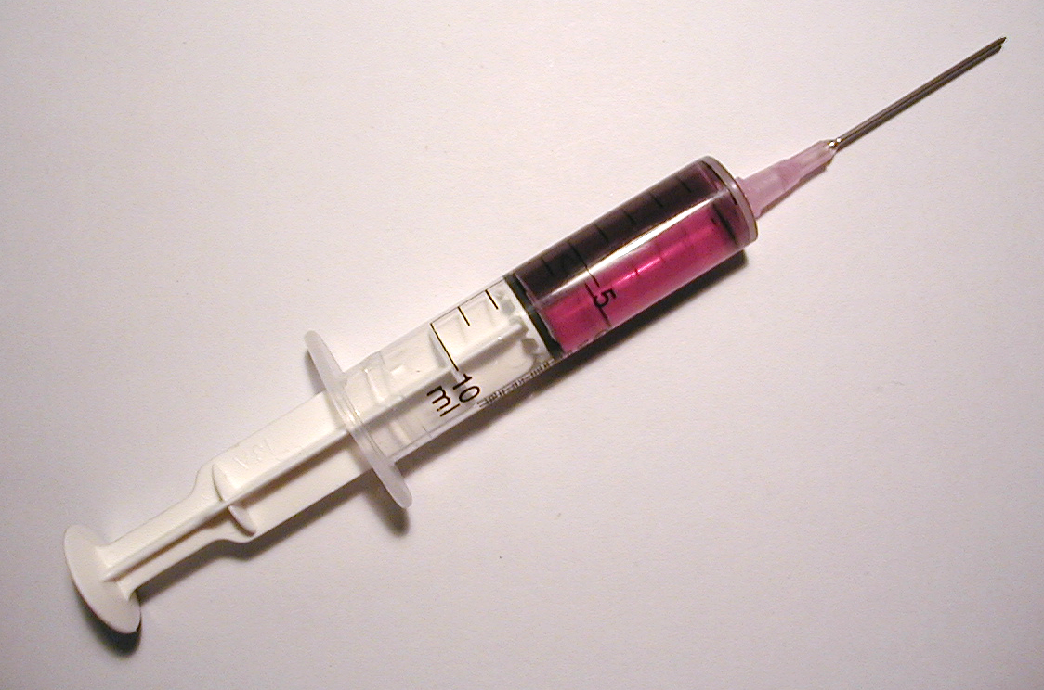
Keyword Injection
SQL Injection
Terminal Escape Sequences

Slide 40
ntop - popen(3)
if(num == 0) putenv(“QUERY_STRING=”);
sprintf(line, “%s/cgi/%s”, getenv(“PWD”), cgiName);
if((fd = popen(line, “r”) == NULL) { ...
cgiName = “;/bin/rm -rf /”

Slide 41
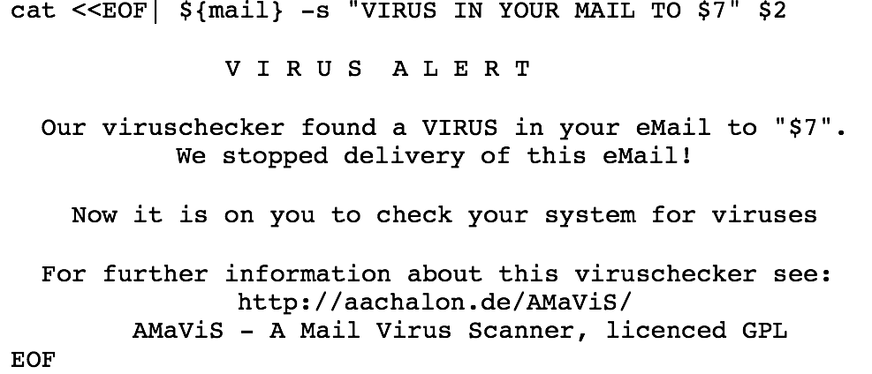
AMaViS: Execute Shell

Slide 42
Ok, what should I do?
Filter untrusted Input
White-List vs. Black-List
a-zA-Z0-9\s is often sufficient
use Escape-Functions, like mysql_ real_string_escape()
avoid Functions that use the Shell, like popen(3), system(3), glob() (Perl), <> (Perl), etc.

Slide 43
What did I not tell you?
… a lot
see Paper
„Sicherheitsrelevante Programmierfehler“
and Slides
„Web-Security Basics“

Slide 44

10 min Coffee Break :-)

Slide 45
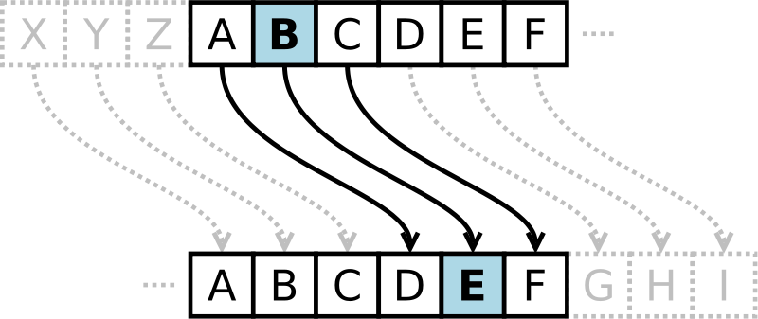
Cryptography
and
Randomness

Slide 46
Random Numbers
max. Entropy: Hmax = 1, if P = 0,5 +/- e; for e = 0
statistical Randomness vs. cryptographical Randomness
important Building Block for Algorithms and Protocols
... but hard to find on a deterministic Machine

Slide 47
Random Numbers
most Unix-like Systems provide /dev/random or /dev/urandom
read(2) instead of fread(3) (no Buffering/Read-Ahead)
Usage of Hash Algorithms hide real Quality
avoid PRNGs from Software Libraries
if Kernel Support is not available, use EGADS or EGD
or: Counter-Mode Block-Cipher and a random IV

Slide 48
novell-NLDAPsdk and BBS
The Code uses a Blum-Blum-Shub (BBS) Generator as Fallback
Unfortunately it generates the random Seed (which is the important Component regarding Security of this Algorithm) from System Time
System Time has only a few Bits of Entropy
  Result: Can be guessed relatively easy and therefore weakens the whole Crypto building on it.

Slide 49
novell-NLDAPsdk and BBS
Lesson learned:
  #1: Do not use the System Time as random Source
  #2: Entropy is a valuable Resource. When you have n Bits of Entropy you will never get more from it with deterministic Operations, but it is possible to accidently reduce Entropy. (MD5 of 512 Bits of Entropy results in 128 Bits of Entropy)

Slide 50
CASA/novell-lum: Password Salt
Salt is used to stop a Code Book Attack
novell-lum used static Salts
CASA used the Hash Value of the Password as Salt (therefore constant regarding Password)
  Result: Password can be cracked easily.
Lesson learned:
  use a random and changing Salt

Slide 51
CASA: Password Cache
micasad secures the cached Password by XOR’ing it with the Output of C#’s Random() Function seeded with a Timestamp
  Result: Two values XOR’ed with the same Value can be XOR’ed together to remove the “Key”
  Result: Assuming 12 hrs Runtime needs 2^39 Operations to decrypt all Values
  Result: Random() is predictable if an Attacker knows the Output (no Forward Security); Timestamp is BAD

Slide 52
CASA: Password Cache
Lessons learned:
  #1: In this Case using a Timestamp is ok but needs an additional Value which changes everytime (i.e. a Sequence Number)
  # 2: Better add an additional Secret (i.e. a Master Password)

Slide 53
CASA: Password Store
CASA encrypts the Password Store with AES in CBC Mode
When calling RijndaelManaged.CreateEncryptor() the Initialisation Vector (IV) is not random/ changing
  Result: Every Data encrypted under the same Key has the same IV which leaks Information about the first Plaintext Block

Slide 54
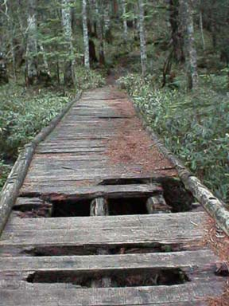
Secure Socket Layer
SSL and TLS

Slide 55
kopete and im.novell.com
Problem #1: The first Version of Kopete’s GW Plugin does not verify the SSL-Cert :(
  Result: Everyone can sniff/modify GWIM Traffic
Problem #2: The SSL-Cert for im.novell.com was incorrect because of CN=im.provo.novell.com and an unknown CA-Cert
  Result: Kopete opens a Accept/Reject Dialog

Slide 56
kopete and im.novell.com
Problem #3: interactive Cert Verification is not possible because the Cert and its Fingerprint is not displayed
  Result: Users start to click “Accept” to get their Work done
  Result: All GWIM can be sniffed.
Problem #4: All other GWIM Clients work without stumbling over the invalid Cert :(

Slide 57
kopete and im.novell.com
Lessons learned:
  #1: verify received Certs!
  #2: only use valid Certs ;-)
  #3: be as verbose as possible when using interactive Cert Verification
  #4: make needed CA-Certs available for your Clients (safely)

Slide 58
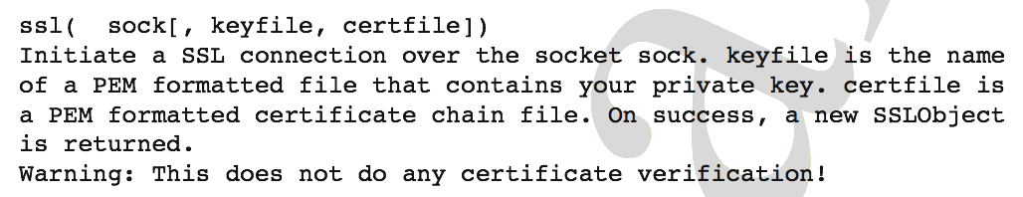
Red Carpet Client and Python
rug was written in Python and uses its HTTPSConnection Class
  Result: Everyone can sniff RC Traffic
Comment in Python Docmentation:

Slide 59
Red Carpet Client and Python
rug used HTTP Digest Authentication (HDA) encapsulated in SSL without Integrity Checking
  Result: After we broke the SSL Part we were able to read the Traffic in Plaintext. Without the Integrity Check from HDA we were also able to modify the command Stream!

Slide 60
Red Carpet Client and Python
Lessons learned:
  #1: RTFM ;-)
  #2: A Chain of Security Mechanisms is only as strong as its weakest Link
  #3: Use a secure SSL add-on for Python

Slide 61
novell-lum and User-friendliness
The Components communicate with the LDAP Server via an SSL connection
If the Component is not able to verify the Cert it uses the Callback Routine provided by OpenSSL to import a possibly missing CA-Cert - instead of using this Routine for interactive Verification (as designed) - and returns SUCCESS
  Result: Everyone can sniff/modify Traffic
  Result: Remote, un-authorized Logins

Slide 62
novell-lum and User-friendliness
Lessons learned:
  #1: RTFM ;-)
  #2: Do not try to be clever by assuming an Operation Environment/Security Policy. And do not use questionable Workarounds based on this Assumtions.

Slide 63
Dos and Don’ts
SSL Version >= 3 (TLS)
take care, some Algorithms are out-dated (DES)
take care, Keys can be too small
  symmetric Ciphers: Key-Length >= 128 Bit
  asymmetric Ciphers: Key-Length >= 1024 Bit
take care, “exportable” Ciphers are weak and not needed
take care, never loose the Private-Key

Slide 64
Dos and Don’ts
use Ephemeral Keying = Perfect Forward Secrecy (PFS)
PRNG needs a random Seed (at least as much random Bits as Length of Key to be generated)
SSL-Session Parameters need to be re-newed when big Amounts of Data are transfered (Hash Collisions, Wrap-Arounds of Seq. Numbers, etc.)
Directory of CA-Certs should only be write-able by root (take care with LDAP Directories and alike)
and at least: Verify the Certificates!

Slide 65
What can I do?
Am I safe with AppArmor, SELinux, etc.? No!
Am I safe with all this nifty gcc Options? No!
So, am I lost? No!
  fully understand the Prg. Language you use
  check your Program’s Input (Type, Size, ...)
  use existing Crypto Libraries when needed
  if in doubt, ask the Security-Team other Developers

Slide 66
http://www.suse.de/~thomas/papers/
“Sicherheitsrelevante Programmierfehler”
“Security Guidelines”
http://www.suse.de/~thomas/projects/
use libsecprog

